Slide 1

Angular
Instructor : Youssef RAFII
From 04/05/2020 To 11/05/2020

Slide 2

Training plan
ANGULAR
First Day
Introduction & Versions
Basics
Second Day
Databinding
Third Day
Pipes
Routing
Forms: Reactive
Making Http Requests
Directives
Observables
Installation
Services & Dependency Injection
Forms: Template driven
Fourth Day
Authentication

Slide 3
First Day
Introduction & Versions
Installation
Basics
Directives

Slide 4
Introduction & Versions

Slide 5

Introduction & Versions
ANGULAR
From Official Angular Web site
“Angular is an app-design framework and development platform for creating efficient and sophisticated single-page apps.”

Slide 6
Introduction & Versions
ANGULAR
2
May 2016
Complete Re-Write of AngularJs
OOP

Slide 7
Introduction & Versions
ANGULAR
March 2017
Angular 2 compatible
Lot of performance improvement
Animation features are separated from @angular/core to @angular/animation
Adding HttpClient (Make http API as deprecated)
Conditionally disable animations
4

Slide 8
Introduction & Versions
ANGULAR
5
November 2017
Build optimizations
improvements of the perfs
Compiler Improvements

Slide 9
Introduction & Versions
ANGULAR
6
May 2018
No major breaking changes
RxJS v6
Angular CLI Changes: Two new commands have been introduced
— ng update <package> — ng add <package>

Slide 10
Introduction & Versions
ANGULAR
7
October 2018
TypeScript 3.1 Support
Angular CLI prompt user

Slide 11
Introduction & Versions
ANGULAR
8
May 2019
Internal changes
@angular/http is no longer supported, use @Angular/common/http instead
ViewChild changed temporary

Slide 12
Introduction & Versions
ANGULAR
9
February 2020
Internal changes
Faster testing
Improved CSS class and style binding
ViewChild returned as before

Slide 13
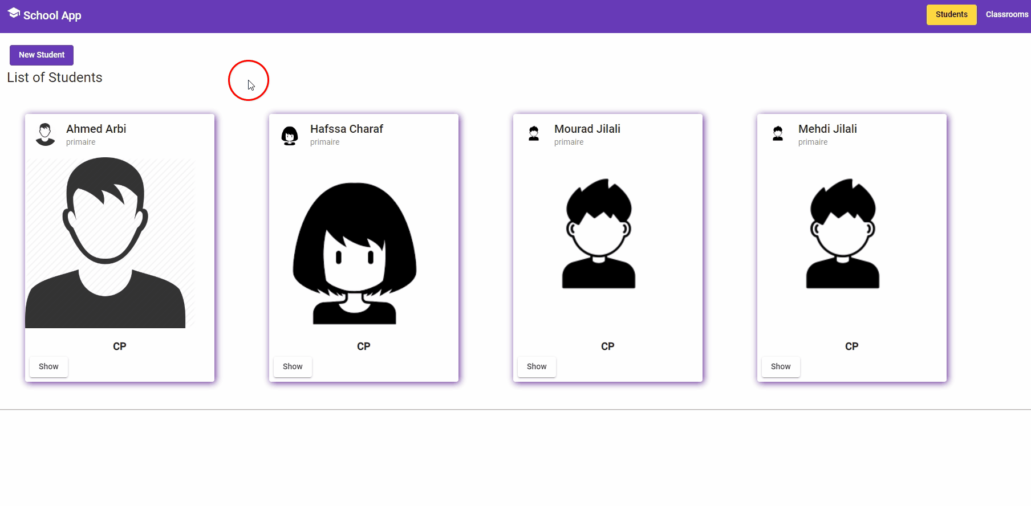
What will be done during this training
ANGULAR

Slide 14
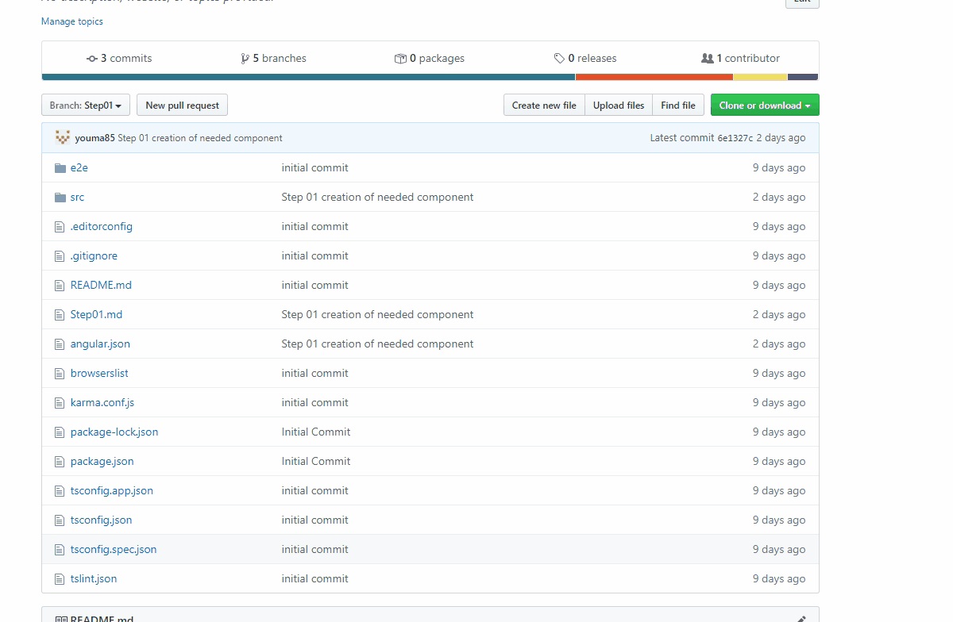
Code in a git repository by Steps
ANGULAR

Slide 15
Installation

Slide 16



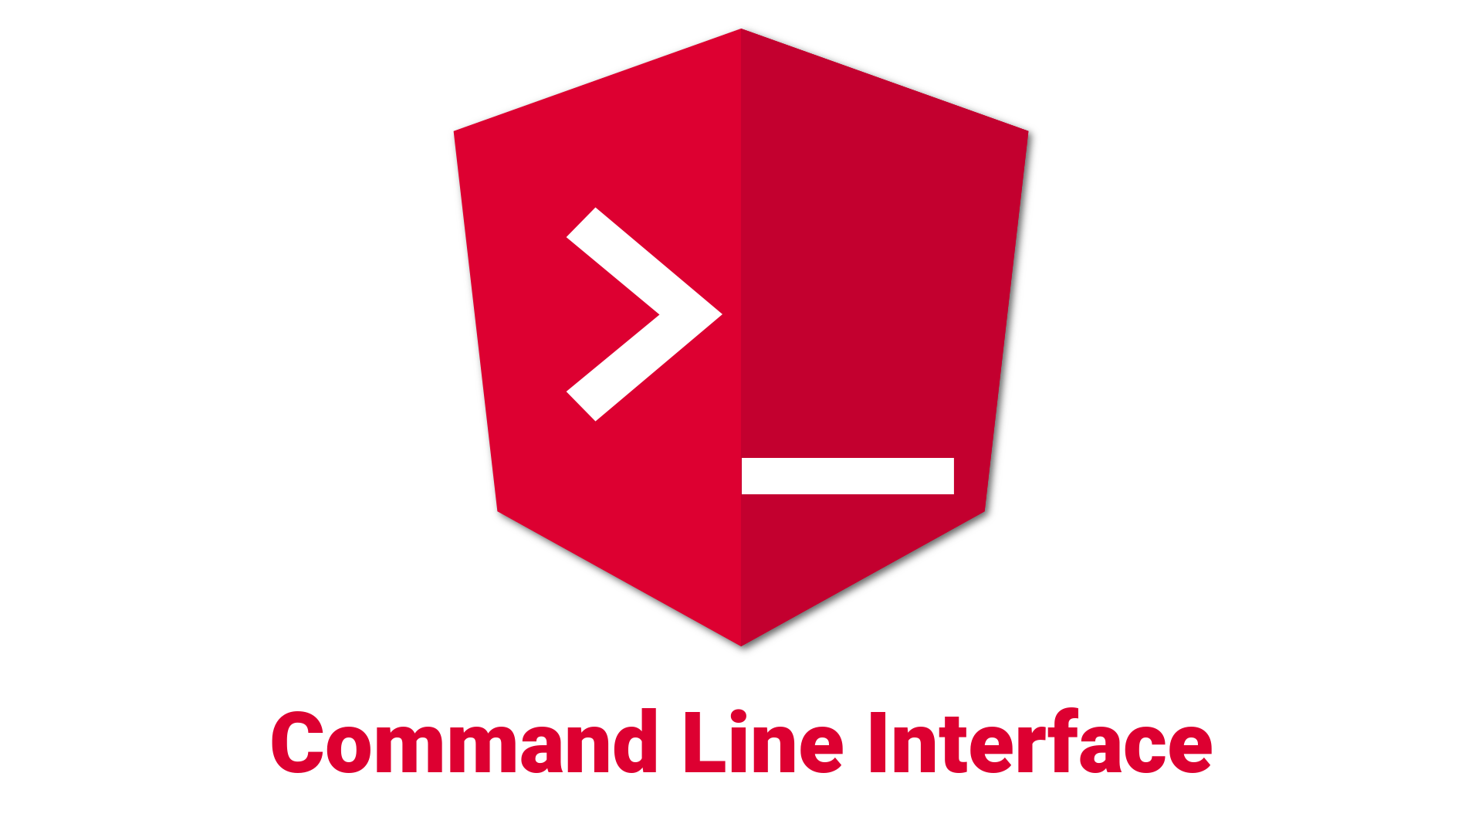
Setup Environment
ANGULAR
 | Node JS | https://nodejs.org/en/download/releases/
 | Git | https://git-scm.com/downloads
 | VsCode | https://code.visualstudio.com/
 | Angular Cli | https://cli.angular.io/

Slide 17
Node Js
ANGULAR
Angular requires a current, active LTS, or maintenance LTS version of Node.js.
Download the current version from here: https://nodejs.org/en/download/current/
To check your version, run:
node -v in a terminal/console window.

Slide 18
Angular Cli
ANGULAR
Installation:
npm install -g @angular/cli
Update to the latest version:
npm uninstall -g @angular/cli
npm cache clean –force
npm install -g @angular/cli

Slide 19
CLI Overview
ANGULAR
ng add: Adds support for an external library to your project.
ng build(ng b): Compiles an Angular app into an output directory named dist/ at the given output path.
ng deploy: Invokes the deploy builder for a specified project or for the default project in the workspace.
ng doc (ng d): Opens the official Angular documentation (angular.io) in a browser, and searches for a given keyword.
ng generate(ng g): Generates files based on a schematic.
For more informations:
https://angular.io/cli

Slide 20
Basics

Slide 21
Create new Angular App
ANGULAR
Run the CLI command ng new and provide the name as shown here:
ng new my-app
The ng new command prompts you for information about features to include in the initial app. Accept the defaults by pressing the Enter or Return key.
Go to the workspace folder (my-app).
Launch the server by using the CLI command ng serve, with the --open option:
cd my-app
ng serve
The ng serve command launches the server, watches your files, and rebuilds the app as you make changes to those files.

Slide 22
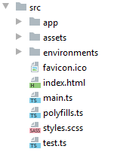
The contents src folder
ANGULAR
Asset | Role
app | Contains the primary App component and module
assets | Empty directory to store static assets like images
environments | Environment configurations to allow you to build for different targets, like dev, qualification or production
favicon.ico | Image displayed as browser favorite icon
index.html | Root HTML file for the application
main.ts | Entry point for the web application code
polyfills.ts | Imports some common polyfills required to run Angular properly on some browsers
styles.css | Global stylesheet
test.ts | Unit test entry point, not part of application

Slide 23
App component
ANGULAR
App component is the root of the application
@Component({ selector: 'app-root', templateUrl: './app.component.html', styleUrls: ['./app.component.scss'] }) export class AppComponent { }
Import the component annotation
Define the component
and its properties
Create the component controller,

Slide 24
App module
ANGULAR
The App module is the packaging that tells Angular what’s available to render
import { BrowserModule } from '@angular/platform-browser'; import { NgModule } from '@angular/core'; import { AppComponent } from './app.component'; @NgModule({ declarations: [ AppComponent ], imports: [ BrowserModule ], providers: [], bootstrap: [AppComponent] }) export class AppModule { }
Imports Angular dependencies needed
Imports the App component
Uses the NgModule annotation to define a module by passing an object
Declarations are to list any components and directives used in the app.
Imports are other modules that are used in the app.
Providers are any services used in the app.
Bootstrap declares which component to use as the first to bootstrap the application.

Slide 25
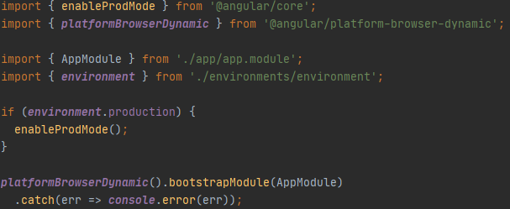
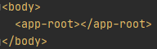
Bootstrapping the app
ANGULAR
main.ts
If production is enabled, turn off Angular developer mode.
Bootstraps the App module
index.html
Angular will look for the app-root element and replace it with the rendered component.

Slide 26
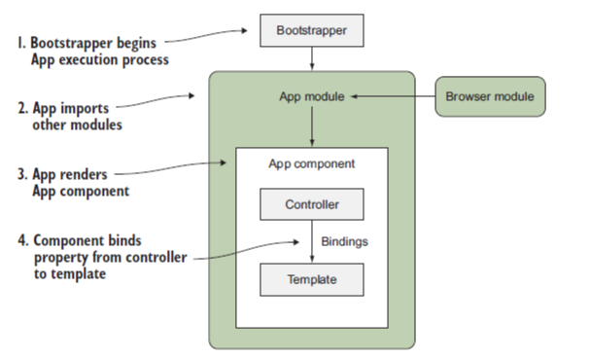
Bootstrapping the app
ANGULAR
Notes:
Immediately upon loading the page, the bootstrapper is called to begin Angular execution.
Now that Angular has started, it loads your App module and reads through any additional dependencies that need to be loaded and bootstrapped.
Then Angular renders the App component, which is the root element of the application.

Slide 27
Basics: Components
ANGULAR
Components are the most basic UI building block of an Angular app. An Angular app contains a tree of Angular components.
Home
Tasks
Notes:
Angular components form the data structure of your application. The HTML template associated with a component provides the means to display that data in the context of a web page. Together, a component's class and template form a view of your application data.
https://angular.io/guide/displaying-data

Slide 28
Basics: Components creation
ANGULAR
We can create component in 2 ways:
Using angular cli:
ng generate component tasks --spec false or shortly (ng g c tasks --spec false)
Manually by creating the class and declare it in the app module file:
@Component({ selector: 'app-student', templateUrl: './student.component.html', styleUrls: ['./student.component.scss'] }) export class StudentComponent { }
@NgModule({ declarations: [ AppComponent, StudentComponent, ]

Slide 29
Basics: Component selector type
ANGULAR
app-root: used as <app-root>
[app-root]: used as <div app-root>
.app-root: used as <div class="app-root">

Slide 30
Basics: Databinding
ANGULAR
Databinding = communication between ts code and what you see (html)
String Interpolation
Allow us to display information from typescript in the html code like variables or functions. E.g.:
Property binding
[property]: indicate to angular that we want to dynamically bind some property of the tag. E.g.:
{{student.firstName}}
<button [disabled]="isFormValid"></button>
Notes:
The process of combining data values with their representation on the page is called data binding. You display your data to a user (and collect data from the user) by binding controls in the HTML template to the data properties of the component class.

Slide 31
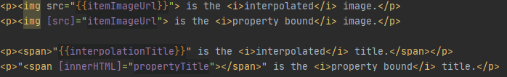
Basics: Databinding
ANGULAR
You often have a choice between interpolation and property binding. The following binding pairs do the same thing:
“When rendering data values as strings, there is no technical reason to prefer one form to the other, though readability tends to favor interpolation. However, when setting an element property to a non-string data value, you must use property binding.”
https://angular.io/guide/template-syntax#property-binding-vs-interpolation

Slide 32
Basics: Databinding
ANGULAR
Event binding
Event binding allows you to listen for certain events such as keystrokes, mouse movements, clicks, and touches.
Two-Way-databinding
For Two-Way-Binding to work, you need to enable the ngModel directive by adding the FormsModule to the imports[] array in the AppModule.
With two way databinding we combine property and event binding.
<button (click)="onNewStudent()">New Student</button>
<input name="lastName" [(ngModel)]="student.lastName" >
Notes:
Binding types and targets:
https://angular.io/guide/template-syntax#binding-types-and-targets

Slide 33
Basics: Directives
ANGULAR
Directives are attributes that changes the appearance or behavior of a DOM element.
There are three kinds of directives in Angular:
Components: directives with a template.
Structural directives: change the DOM layout by adding and removing DOM elements, for example *ngFor and *ngIf.
Attribute directives: change the appearance or behavior of an element, component, or another directive, for example ngStyle

Slide 34
Basics: NgIf
ANGULAR
With else
<p *ngIf="boolean"></p>
<p *ngIf="boolean; else elseBlock "></p> <ng-template #elseBlock> </ng-template>

Slide 35
Basics: NgStyle
ANGULAR
with a Object:
<button [ngStyle]="{background: 'red'}">Click Me!</button>
with a function:
<p [ngStyle]="{backgroundColor:getColor()}"></p>
getColor(){ return this.status==='done'? 'green': 'red'; }

Slide 36
Basics: NgClass
ANGULAR
with a class name:
.online { color: blue; } .active { background-color: yellow; }
<p [ngClass]="'online'">paragraph 1</p>
with a multiple class name:
<p [ngClass]="'online active'">paragraph 1</p>
Conditionnal application of classes
<p [ngClass]="{ online: false, active: false }">paragraph 1</p>
With databinding
<p [ngClass]="{ online: !isValid }">paragraph 1</p>

Slide 37
Basics: NgFor
ANGULAR
Get the index
*ngFor="let std of students"
*ngFor="let std of students; let i= index"

Slide 38
NgSwitch
ANGULAR
<div [ngSwitch]="value"> <p *ngSwitchCase="5">Value is 5</p> <p *ngSwitchCase="10">Value is 10</p> <p *ngSwitchCase="100">Value is 100</p> <p *ngSwitchDefault>Value is default</p> </div>

Slide 39
Directives

Slide 40
Custom directives
ANGULAR
@Directive({ selector: '[appShadow]' }) export class ShadowDirectiveDirective { constructor(elem: ElementRef, renderer: Renderer2) { renderer.setStyle(elem.nativeElement, 'box-shadow', '2px 2px 12px #602593'); } }
Must be declared in the app.module
@NgModule({ declarations: [ AppComponent, StudentComponent, ShadowDirectiveDirective ],
<div appShadow> … </div>
Creation with CLI: ng g d directive_name

Slide 41
Directives Listener
ANGULAR
@HostListener('mouseenter') mouseOver(eventData:Event){ this.elementRef.nativeElement.style.backgroundColor='yellow'; } @HostListener('mouseleave') mouseLeave(eventData:Event){ this.elementRef.nativeElement.style.backgroundColor='transparent'; }

Slide 42
Using HostBinding to Bind to Host Properties
ANGULAR
Bind style.backgroundColor to the property backgroudColor:
@HostBinding('style.backgroundColor') backgroundColor:string='transparent'; @HostListener('mouseenter') mouseOver(eventData:Event){ this.backgroundColor='yellow'; } @HostListener('mouseleave') mouseLeave(eventData:Event){ this.backgroundColor='transparent'; }

Slide 43
Second Day
ANGULAR
Components & Databinding
Pipes
Services & Dependency Injection

Slide 44
Components & Databinding

Slide 45
Input: Property Binding
ANGULAR
To transmit data to a "child component", we will communicate with it in the same way as we control the properties of a native element, that is to say using the Property Binding:
<app-student-item *ngFor="let std of students" [student]="std">
</app-student-item>
This block of code will call an implicit "set" of the «student» property of the instance of the Parent component.

Slide 46
Input: @Input Decorator
ANGULAR
By default, no component property can be changed by Property Binding. It is therefore necessary to define the properties that can serve as "input" to the component by simply adding the decorator @Input().
export class StudentItemComponent implements OnInit { @Input() student: Student;
}

Slide 47
Input: Binding To custom property
ANGULAR
@Component({ selector: 'app-student-list', template: `
<app-student-item *ngFor="let std of students" [student]="std">
</app-student-item>` }) export class StudentListComponent implements OnInit { students: Student[] = []; }
@Component({ selector: 'app-student-item’, template: ` <h3>Name: {{student.name}}</h3> ` }) export class StudentItemComponent { @Input() student: Student; }

Slide 48
Input: Binding To custom property(alias)
ANGULAR
@Component({ selector: 'app-student-list', template: `
<app-student-item *ngFor="let std of students" [stdElm]="std">
</app-student-item>` }) export class StudentListComponent implements OnInit { students: Student[] = []; }
@Component({ selector: 'app-student-item’, template: ` <h3>Name: {{student.name}}</h3> ` }) export class StudentItemComponent { @Input('stdElm') student: Student; }

Slide 49
Output: Event Binding
ANGULAR
In the same way that Inputs allow you to communicate data to a "child component", Output can transmit data to the "parent component" via an "Output" mechanism similar to the Event Binding used previously to capture nativehes
events.
<app-student-item *ngFor="let std of students" (studentSelected)="onSelectingStudent(std)">
</app-student-item>
The expression onSelectingStudent(std) allows to register a listener for the «studentSelected» event.
Note the similarity with the Event Binding on click event(or Other DOM events).
<button (click)="onSave()">Save</button>

Slide 50
Output: Declaration of property and decorator @Output ()
ANGULAR
By simply declaring the studentSelected property on the app-student-item component:
export class StudentItemComponent{ studentSelected: any; }
.. nothing happens, you must add the decorator @Output():
export class StudentItemComponent{ @Output() studentSelected: any; }
@Output allows you to make the eventEmitter listenable from the outside
export class StudentItemComponent{ @Output() studentSelected= new EventEmitter<void>(); }

Slide 51
Output: Sending values
ANGULAR
As indicated by his name, an EventEmitter allows you to emit values. It can therefore be used anywhere in the StudentItemComponent class to pass values to the parent component via the emit method.
<button mat-raised-button (click)="onClick()">Show</button>
onClick() { this.studentSelected.emit(); }

Slide 52
Output: Binding To custom event
ANGULAR
@Component({ selector: 'app-student-list', template: ` <app-student-item *ngFor="let std of students" [student]="std" (studentSelected)="onStudentSelected(std)"></app-student-item> ` }) export class StudentListComponent implements OnInit { students: Student[] = [ ]; onStudentSelected(student: Student) { console.log(student); } }
@Component({ selector: 'app-student-item', template: ` {{student.firstName}} {{student.lastName}} <button mat-raised-button (click)="onClick()">Show</button> ` }) export class StudentItemComponent{ @Input() student: Student; @Output() studentSelected = new EventEmitter<Student>(); onClick() { this.studentSelected.emit(this.student); } }

Slide 53
Local reference
ANGULAR
<input type="text" class="form-control" #serverNameInput> <button class="btn btn-primary" (click)="onAddServer(serverNameInput)">Add Server</button>
onAddServer(name:HtmlInputElement){ console.log(name.value); }

Slide 54
Pipes

Slide 55
Pipe
ANGULAR
Pipes are filters that can be used directly from the view in order to transform the values during the binding.
The Pipes syntax is simply inspired by UNIX shell Pipes found in many templating systems.
Pipes are added into template expressions using the pipe character (|).
<div>{{ user.firstName | lowercase }}</div>
{{ server.started | date}}
Angular has several native "pipes": https://angular.io/api?type=pipe

Slide 56
Pipe with parameters
ANGULAR
Pipes can take parameters that must be puted after the Pipe and separated with the symbol ":".
<div>{{ user.firstName | slice:0:10 }}</div>
{{ student.birthDate | date:'fullDate'}}

Slide 57
Chaining
ANGULAR
The "pipes" can be chained.
<div>{{ student.firstName | slice:0:10 | lowercase }}</div>
{{ server.started | date:'fullDate'| uppercase}}

Slide 58
Creating a Custom Pipe
ANGULAR
To create a custom Pipe, you need:
Create a class that implements the PipeTransform interface,
decorate this class with the decorator @Pipe () by indicating the name of the Pipe.
add the class to the declarations (and exports) of the associated module.
Creation with angular CLI: ng g p namePipe

Slide 59
Creating a Custom Pipe
ANGULAR
import { PipeTransform } from "@angular/core"; @Pipe({ name:'shorten' }) export class ShortenPipe implements PipeTransform{ transform(value:any){ if(value.length>10){ return value.substr(0,10)+'...'; } return value; } }
{{ student.firstName | shorten }}

Slide 60
parametrizing a custom pipe
ANGULAR
import {PipeTransform} from "@angular/core"; @Pipe({ name: 'shorten' }) export class ShortenPipe implements PipeTransform { transform(value: any, limit: number) { if (value.length > limit) { return value.substr(0, limit) + '...'; } return value; } }
{{ student.firstName | shorten:5 }}
{{ student.firstName | shorten:5:arg2:arg3 }}

Slide 61
Services & Dependency Injection

Slide 62
What is "Dependency Injection"?
ANGULAR
The "Dependency Injection" is a "design pattern" which consists in separating the instantiation (and therefore the implementation) of a dependency and its use.
It decreases coupling between a class and its dependency.
Extending the application becomes easier.
Helps in Unit testing.

Slide 63
Injection of an Angular Service
ANGULAR
With Angular, a dependency is generally the instance of a class allowing to factorize certain functionalities or to access a state thus allowing the components to communicate with each other.
In the Angular vocabulary, these classes are called "services".
An Angular service can be injected by any Angular class (i.e.: component, Directive, Service or Pipe) via the parameters of its constructor.
export class StudentListComponent { constructor(private studentService: StudentService) { } }

Slide 64

Services & Providers
ANGULAR
Declaration of a Service:
To declare an Angular service, just create a TypeScript class and decorate it with the decorator @Injectable ().
@Injectable() export class StudentService { }
@Injectable(): tell to angular that this class can inject other service
Definition of a Provider:
In order to instantiate a service, Angular needs a "provider" telling it how to produce the instance of this service.
This is generally done via the providers property in the app module.
@NgModule({ providers: [StudentService], bootstrap: [AppComponent] }) export class AppModule { }

Slide 65
Scope of Services
ANGULAR
AppModule
AppComponent
Any Other Component
Same instance of Service is available Application-wide
Same instance of Service is available for all Components(but Not for other services)
Same instance of Service is available for the Component and all its child components

Slide 66
Services in Angular 6+
ANGULAR
Since Angular 6, it is no longer necessary to define "providers" at the module level.
Instead of adding a service class to the providers[] array in AppModule , you can set the following config in @Injectable() :
@Injectable({ providedIn: 'root' }) export class StudentService {
}

Slide 67
Third Day
ANGULAR
Routing
Observables
Forms: Template driven

Slide 68
Routing

Slide 69
Setting up of "Routing"
ANGULAR
The "Routing" configuration is transmitted to the RouterModule module when it is imported by the AppModule "root module".
const appRoutes: Routes = [ {path: '', redirectTo: '/students', pathMatch: 'full'}, {path: 'students', component: StudentComponent}, {path: 'classrooms', component: ClassroomComponent} ]; @NgModule({ imports: [RouterModule.forRoot(appRoutes)], exports: [RouterModule] }) export class AppRoutingModule { }
it is recommended to place this configuration in a dedicated module AppRoutingModule imported by the "root module" AppModule.
ng generate module app-routing --flat --module=app

Slide 70
Setting up routes with parameters
ANGULAR
The path of a "route" can define mandatory parameters with the prefix :
{path: 'students/:id', component: StudentDetailsComponent}

Slide 71
<router-outlet>
ANGULAR
The configuration of "Routing" allows you to define which component to display according to the route but this does not tell Angular where to inject the component in the page.
To indicate the the loading location of the routes, use the <router-outlet> directive directly in the "root component" AppComponent (or another one).
<router-outlet></router-outlet>

Slide 72
Navigating with Router Links
ANGULAR
Using native links <a href="/students">, the "browser" will generate an HTTP GET request to the server and reload the entire application.
To avoid this problem, the Angular Routing module provides the routerLink directive which allows to intercept the click event on the links and to change the "route" without reloading the whole application.
<a mat-button routerLink="/students">Students</a>

Slide 73
Navigating Programmatically
ANGULAR
The navigatation can be done programmatically with the Router object
import {Router} from "@angular/router";
…
constructor(private router: Router) { }
…
this.router.navigate(['/students']);

Slide 74
Styling Active Router Links
ANGULAR
<a mat-button routerLink="/" routerLinkActive="active" [routerLinkActiveOptions]="{exact:true}">Home</a> <a mat-button routerLink="/students" routerLinkActive="active">Students</a> <a mat-button routerLink="/classrooms" routerLinkActive="active">Classrooms</a>
[routerLinkActiveOptions]="{exact:true}“
Do not activate the routerLinkActive only if the url is exactly ‘/’

Slide 75
Child(Nested) Route
ANGULAR
A child route is like any other route, in that it needs both a path and a component.
The one difference is that you place child routes in a children array within the parent route
{path: 'students', component: StudentComponent, children: [ {path: '', component: StudentListComponent}, {path: 'new', component: CreateStudentComponent}, {path: ':id', component: UpdateStudentComponent} ]},
Must add <router-outlet></router-outlet> in the Html of the Student component

Slide 76
Passing Parameters to Routes
ANGULAR
Configuration:
Calling the route:
…
{path: ':id', component: StudentDetailsComponent}
…
<a [routerLink]="['/students',5]" ></a>
Or programmatically
this.router.navigate(['/students', idStudent]);

Slide 77
Fetching Route Parameters
ANGULAR
import {ActivatedRoute} from "@angular/router";
constructor(private route: ActivatedRoute) { this.id = this.route.snapshot.params['id']; }

Slide 78
Fetching Route Parameters Reactively
ANGULAR
constructor(private route: ActivatedRoute) {
this.id = this.route.snapshot.params['id']; this.route.params .subscribe( (params:Params)=>{ this.id = params['id']; }); }

Slide 79
QueryParams
ANGULAR
<a [routerLink]="['/students']" [queryParams]="{allowEdit:'1'}"></a>
Or programmatically
this.router.navigate([‘/students'],{queryParams:{allowEdit:'1'}});
How to access these values:
With observable:
this.route.snapshot.queryParams
this.route.queryParams.subscribe();

Slide 80
Redirecting and Wildcard Routes
ANGULAR
{path:'not-found',component:PageNotFoundComponent}, {path:'**', redirectTo:'/not-found’}
The path:'**' must be the last route in the appRoutes

Slide 81
Guards
ANGULAR
"Guards" are used to control access to a "route" (e.g. authorization) or departure from a "route".
Configuration:
The "Guards" are added in "Routing" configuration:
{path: 'classrooms', component: ClassroomComponent,canActivate:[IsSignedInGuard]}

Slide 82
CanActivate
ANGULAR
An activation guard is a service that implements the CanActivate interface.
This service must therefore implement the canActivate method which is called on each request for access to the "route"; it must then return a value of type boolean or Promise <boolean> or Observable <boolean> indicating whether access to the "route" is authorized or not.
@Injectable({ providedIn: 'root' }) export class IsSignedInGuard implements CanActivate { constructor(private _session: Session) { } canActivate(route: ActivatedRouteSnapshot, state: RouterStateSnapshot) { return this._session.isSignedIn(); } }

Slide 83
CanDeactivate
ANGULAR
A deactivation guard is a service that implements the CanDeactivate interface.
This service must implement the canDeactivate method.
This method is called whenever the user wishes to leave the route. it must then return a value of type boolean or Promise <boolean> or Observable <boolean> indicating whether access to the "route" is authorized or not.
@Injectable({ providedIn: 'root' }) export class IsNotDirtyGuard implements CanDeactivate<ProfileViewComponent> { canDeactivate(component: ProfileViewComponent, currentRoute: ActivatedRouteSnapshot, currentState: RouterStateSnapshot, nextState?: RouterStateSnapshot): Observable<boolean> | Promise<boolean> | boolean { return component.isDirty(); } }
export class ProfileViewComponent { isDirty() { return false; } }

Slide 84
Lazy Loading
ANGULAR
When the application starts, Angular loads all the modules and all the entities of the application.
If the application is very large then the startup will be slower.
To avoid these scalability problems, Angular allows modules to be loaded on demand (i.e. "Lazy Loading") in order to ease the initial load of the application.

Slide 85
Lazy Loading configuration
ANGULAR
The configuration of "Lazy Loading" is done in the "Routing" configuration.
The AppRoutingModule "Routing" module can delegate the "Routing" management of a part of the application to another module. This "Lazy Loaded" module will therefore be loaded asynchronously when visiting the "routes" for which it is responsible.
{ path: 'classrooms', loadChildren: ‘./classrooms/classroom-routing.module#ClassroomRoutingModule' },
This configuration delegates the "Routing" of all the /classrooms/... part of the application to the ClassroomRoutingModule module.

Slide 86
Observables

Slide 87
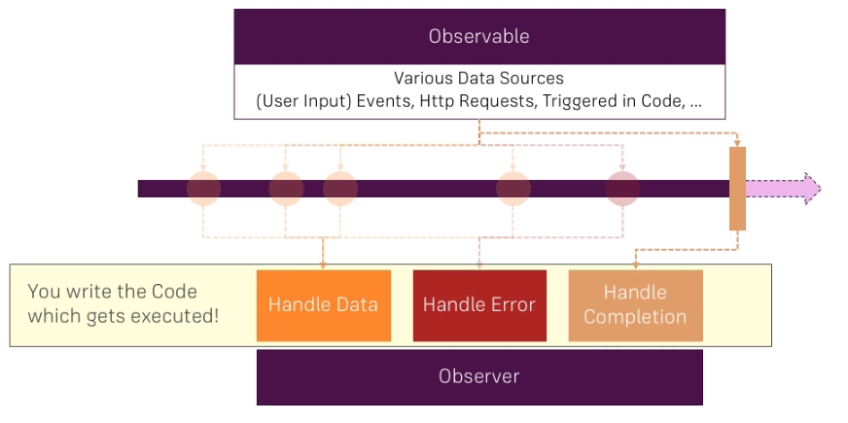
Observables
ANGULAR
Notes:
An observable basically can be thought of as a data source.
On the timeline(or stream), we can have multiple events emitted by the observable or data packages,
So the observable could emit data because you trigger it to do so,
it could be connected to a button and therefore whenever the button is clicked, an event in a data package
is emitted automatically or as the Angular HTTP service does it,
it's connected to a HTTP request.
the observer, this actually is your code you could say.
you can handle the normal data, you can handle errors or you can handle the completion of the observable
There observables that complete such as http request and other dosen’t such as button
Used to handle asychnronus tasks

Slide 88
Observables
ANGULAR
An Observable is an object allowing to make the “link” between publishers and subscribers.
Angular makes use of observables as an interface to handle a variety of common asynchronous operations.
Observables will emit events which will be intercepted by observers.

Slide 89
Observers
ANGULAR
A handler for receiving observable notifications implements the Observer interface.
NOTIFICATION TYPE | DESCRIPTION
next | Required. A handler for each delivered value. Called zero or more times after execution starts.
error | Optional. A handler for an error notification. An error halts execution of the observable instance.
complete | Optional. A handler for the execution-complete notification.

Slide 90
Subscribe to an observable
ANGULAR
In the example below we will create an observable using the interval function which produces a self-incrementing value on a regular basis.
import { interval } from 'rxjs'; const data$ = interval(1000);
As long as you don't subscribe to the "observable", nothing happens because this observable is "lazy".
The common point between all "observables" is the subscribe method which allows you to subscribe to an Observable and be notified of new values, errors or the end of the "stream".
const subscription =data$.subscribe({ next: value => console.log(value), error: err => console.error(err), complete: () => console.log('DONE!') });

Slide 91
Unsubscription
ANGULAR
The subscribe method returns an object of type Subscription.
This object is mainly used to unsubscribe from an Observable via its unsubscribe method.
subscription.unsubscribe ();
The unsubscribe method allows you to:
unsubscribe the "callbacks": next, error and complete;
destroy the Observable (interrupt the processing carried out by the Observable)
possibly free the memory because by unregistering the "callbacks" .

Slide 92
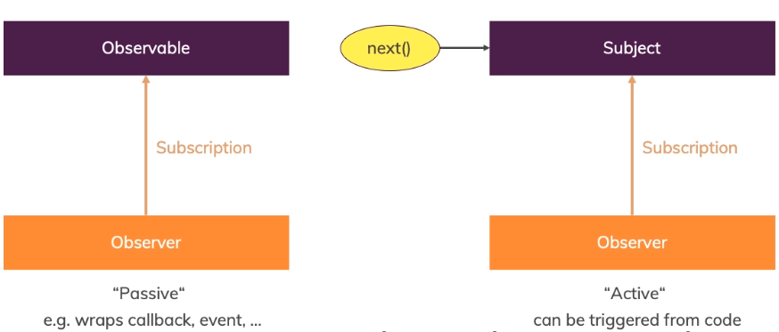
Subject
ANGULAR
A Subject is a special kind of Observable
Notes:
A subject is different, a subject also is an object you can subscribe to but it's more active because you can actively call next on it from outside.
EventEmitter must be use with output otherways use subject

Slide 93
Subject
ANGULAR
A Subject is both an observable AND an observer. We can therefore subscribe to it, but also send it values
const subject = new Subject<number>(); subject.subscribe((number) => { console.log( number); }); subject.next(1); // send value subject.next(2); // send another

Slide 94
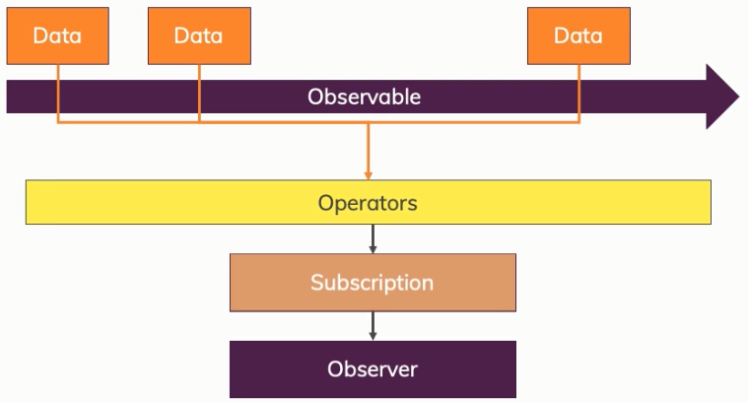
Operators
ANGULAR
An operator makes it possible to define an Observable from another by applying some transformations to it.
Operators are functions that can be applied to an Observable via the pipe method.

Slide 95
map
ANGULAR
The map operator allows you to create a new Observable from the original Observable by transforming each of its values.
import { from } from 'rxjs'; import { map } from 'rxjs/operators'; //emit (1,2,3,4,5) const source = from([1, 2, 3, 4, 5]); //add 10 to each value const example = source.pipe(map(val => val + 10)); //output: 11,12,13,14,15 const subscribe = example.subscribe(val => console.log(val));

Slide 96
filter
ANGULAR
The filter operator allows you to keep only the elements for which the predicate function returns true.
import { from } from 'rxjs'; import { filter } from 'rxjs/operators'; //emit (1,2,3,4,5) const source = from([1, 2, 3, 4, 5]); //filter out non-even numbers const example = source.pipe(filter(num => num % 2 === 0)); //output: "Even number: 2", "Even number: 4" const subscribe = example.subscribe(val => console.log(`Even number: ${val}`));

Slide 97
Forms: Template driven

Slide 98
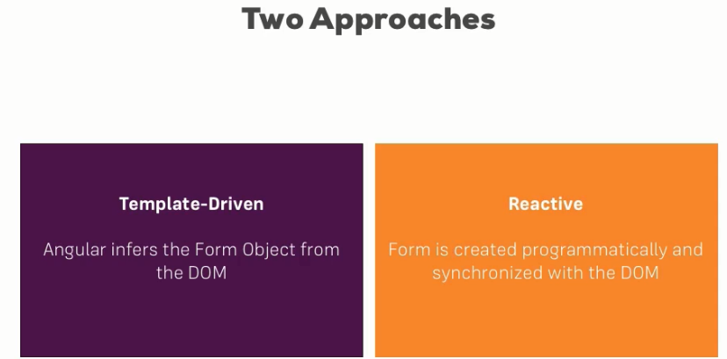
Forms
ANGULAR

Slide 99
TD vs Reactive
Template Driven Forms Features | Reactive Forms Features
Easy to use | More flexible, but needs a lot of practice
Suitable for simple scenarios | Handles any complex scenarios
Two way data binding(using [(NgModel)] syntax) | No data binding is done
Minimal component code | More component code and less HTML markup
Automatic track of the form and its data(handled by Angular) | Adding elements dynamically

Slide 100
TD: Registering the Controls
ANGULAR
First of all the module FormsModule must be imported in the app.module
To register a control we have to add NgModel and a name for this control
<form> <input type="text" id="username" class="form-control" ngModel name="username"> </form >

Slide 101
TD: Submitting and Using the Form
ANGULAR
<form (ngSubmit)="onSubmit(f)" #f="ngForm"> ... </form >
import { NgForm } from '@angular/forms’; … onSubmit(form:NgForm){ console.log(form); }

Slide 102
TD: Adding Validation to check User Input
ANGULAR
<input type="text" id="username" class="form-control" ngModel name="username" required minlength="4">

Slide 103
TD: Using form state
ANGULAR
<button type="submit" [disabled]="!f.valid">Submit</button>
input.ng-invalid, select.ng-invalid { border: 1px solid red; }

Slide 104
TD: Outputting Validation Error Messages
ANGULAR
<input type="email" id="email" class="form-control" ngModel name="email" required email #email="ngModel"> <span class="help-block" *ngIf="!email.valid && email.touched"> Please enter a valid email </span>

Slide 105
TD: Using ngModel with Two-Way-Binding
ANGULAR
<div class="form-group"> <textarea class="form-control" name="questionAnswer" rows="3" [(ngModel)]="answer"> </textarea> </div>
<p>Your reply:{{answer}}</p>

Slide 106
TD: Grouping Form Controls
ANGULAR
<div id="user-data" ngModelGroup="userData" #userData="ngModelGroup"> … control s here </div> <p *ngIf="!userData.valid && userData.touched">user Data is invalid</p>

Slide 107
TD: Handling Radio Buttons
ANGULAR
<div class="radio" *ngFor="let g of genders"> <label> <input type="radio" name="gender" ngModel [value]="g">{{g}} </label> </div>
genders=['male','female'];

Slide 108
TD: Using Form Data
ANGULAR
user={ username:'', email:'', secretQuestion:'', answer:'', gender:'' }; … onSubmit(){ this.user.username=this.myForm.value.userData.username; this.user.email=this.myForm.value.userData.email; this.user.gender=this.myForm.value.gender; this.user.secretQuestion=this.myForm.value.secret; this.user.answer=this.myForm.value.questionAnswer; }

Slide 109
TD: Reset a form
ANGULAR
this.myForm.reset();

Slide 110
Fourth Day
ANGULAR
Forms: Reactive
Making Http Requests
Authentication

Slide 111
Forms: Reactive

Slide 112
Reactive: Creation of the form
ANGULAR
Must import the ReactiveFormsModule in app.module.ts
signupFrom: FormGroup;
ngOnInit(){
this.signupFrom= new FormGroup({
'username': new FormControl(null),
'email': new FormControl(null),
'gender': new FormControl('male')
});
}

Slide 113
Reactive: Syncing HTML and Form
ANGULAR
<form [formGroup]="signupFrom">
<div class="form-group">
<label for="username">Username</label>
<input
type="text"
id="username"
formControlName="username"
class="form-control">
</div>
...
</form>

Slide 114
Reactive: submit de form
ANGULAR
<form [formGroup]="signupFrom" (ngSubmit)="onSubmit()">
…
<form>
onSubmit(){
console.log(this.signupFrom);
}

Slide 115
Reactive: Validation
ANGULAR
this.signupFrom= new FormGroup({
'username': new FormControl(null, Validators.required),
'email': new FormControl(null, [Validators.required,Validators.email]),
'gender': new FormControl('male')
});

Slide 116
Reactive: Getting Access to Controls
ANGULAR
<span
*ngIf="!signupFrom.get('username').valid && signupFrom.get('username').touched"
class="help-block">
Please enter a valid username
</span>
input.ng-invalid.ng-touched{
border: 1px solid red;
}

Slide 117
Reactive: Group Control
ANGULAR
<div formGroupName="userData">
<div class="form-group">
<label for="username">Username</label>
<input type="text" id="username" formControlName="username" class="form-control”>
</div>
<div class="form-group">
<label for="email">email</label>
<input type="text" id="email" formControlName="email" class="form-control">
</div>
</div>
this.signupFrom= new FormGroup({
'userData':new FormGroup({
'username': new FormControl(null, Validators.required),
'email': new FormControl(null, [Validators.required,Validators.email])
})
});

Slide 118
Arrays of Form Controls (FormArray)
ANGULAR
ngOnInit(){
this.signupFrom= new FormGroup({
…,
'hobbies':new FormArray([])
});
}
<div formArrayName="hobbies">
<h4>Your hobbies</h4>
<button class="btn btn-default" type="button" (click)="onAddHobby()">
Add Hobby</button>
<div class="form-group" *ngFor="let hobby of getControls(); let i=index">
<input type="text" class="form-control" [formControlName]="i">
</div>
</div>

Slide 119
Arrays of Form Controls (FormArray)
ANGULAR
getControls() {
return (<FormArray>this.signupForm.get('hobbies')).controls;
}
onAddHobby(){
const control=new FormControl(null,Validators.required);
(<FormArray>this.signupFrom.get('hobbies')).push(control);
}

Slide 120
Http Requests

Slide 121
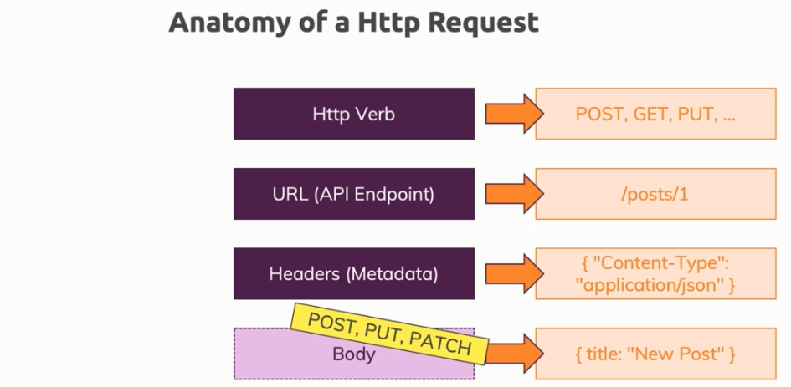
Making HTTP Requests
ANGULAR
must import the module HttpClientModule in app.module
import { HttpClientModule } from '@angular/common/http'

Slide 122
Sending a POST Request
ANGULAR
constructor(private http: HttpClient) {}
addHero (hero: Hero): Observable<Hero> {
return this.http.post<Hero>(this.heroesUrl, hero);
}
this.heroesService .addHero(newHero)
.subscribe(
hero => this.heroes.push(hero)
);

Slide 123
Sending a PUT Request
ANGULAR
constructor(private http: HttpClient) {}
updateHero (hero: Hero): Observable<Hero> {
return this.http.put<Hero>(this.heroesUrl, hero);
}

Slide 124
GETting Data
ANGULAR
private fetchPosts() {
this.http
.get(url)
.subscribe(posts => {
console.log(posts);
});
}

Slide 125
Delete request
ANGULAR
deleteHero (id: number): Observable<{}> {
const url = `${this.heroesUrl}/${id}`; // DELETE api/heroes/42
return this.http.delete(url);
}
this.heroesService .deleteHero(hero.id).subscribe();

Slide 126
Handling Errors
ANGULAR
this.postService.fetchPosts().subscribe(posts=>{
this.loadedPosts = posts;
}, error => {
this.error = error.message;
}
);
<div class="alert alert-danger" *ngIf="error">
<h1>An error has occured</h1>
<p>{{error}}</p>
</div>

Slide 127
Setting Headers
ANGULAR
return this.http
.get<{ [key: string]: Post }>(
url,
{
headers: new HttpHeaders({'Custom-header' : 'hello'})
}
)

Slide 128
Adding Query Params
ANGULAR
let searchParams = new HttpParams();
searchParams = searchParams.append('print', 'pretty');
searchParams = searchParams.append('custom', 'key');
return this.http
.get<{ [key: string]: Post }>(
url,
{
headers: new HttpHeaders({'Custom-header' : 'hello'}),
params: searchParams
}
)

Slide 129
Introducing Interceptors
ANGULAR
export class AuthInterceptorService implements HttpInterceptor {
intercept(req: HttpRequest<any>, next: HttpHandler) {
const modifiedReq = req.clone({
headers: req.headers.append('Auth', 'xyz')
});
return next.handle(req);
}
}
@NgModule({
…
providers: [{provide : HTTP_INTERCEPTORS, useClass: AuthInterceptorService, multi : true}],
…
})

Slide 130
Authentication

Slide 131
How authentication works
ANGULAR
Storage
Stores the token
Client
Send Auth Data
Send the token in requests
Token
Session
Server
Notes:
Session?:
- can’t be used because the server and client are decoupled
- The backends are stateless

Slide 132

QUESTIONS
ANGULAR

Slide 133
SESSION END
ANGULAR
THANK YOU
for
your
ATTENTION

Slide 134
ANNEX
ANGULAR

Slide 135
Source code
ANGULAR
Source code can be found in this github Link:
https://github.com/youma85/schoolAng

Slide 136
TypeScript(Types)
ANGULAR
In typeScript, type System represents different types of datatypes which are supported by TypeScript.
BUILT-IN DATA TYPE | KEYWORD | DESCRIPTION
Number | number | It is used to represent both Integer as well as Floating-Point numbers
Boolean | boolean | Represents true and false
String | string | It is used to represent a sequence of characters
Void | void | Generally used on function return-types
Null | null | It is used when an object does not have any value
Undefined | undefined | Denotes value given to uninitialized variable
Any | any | If variable is declared with any data-type then any type of value can be assigned to that variable

Slide 137
TypeScript(Classes)
ANGULAR
TypeScript is object oriented JavaScript. TypeScript supports object-oriented programming features like classes, interfaces, etc. A class in terms of OOP is a blueprint for creating objects. A class encapsulates data for the object.
class Car {
//field
engine:string;
//constructor
constructor(engine:string) {
this.engine = engine
}
//function
disp():void {
console.log("Engine is : "+this.engine)
}
}

Slide 138
TypeScript(Interfaces)
ANGULAR
An interface is a syntactical contract that an entity should conform to. In other words, an interface defines the syntax that any entity must adhere to.
interface IPerson {
firstName:string,
lastName:string,
sayHi: ()=>string
}

Slide 139
ES6+:versions (from www.w3schools.com)
ANGULAR
Ver | Official Name | Description
1 | ECMAScript 1 (1997) | First Edition.
2 | ECMAScript 2 (1998) | Editorial changes only.
3 | ECMAScript 3 (1999) | Added Regular Expressions. Added try/catch.
4 | ECMAScript 4 | Never released.
5 | ECMAScript 5 (2009) | Added "strict mode". Added JSON support. Added String.trim(). Added Array.isArray(). Added Array Iteration Methods.
5.1 | ECMAScript 5.1 (2011) | Editorial changes.
6 | ECMAScript 2015 | Added let and const. Added default parameter values. Added Array.find(). Added Array.findIndex().
7 | ECMAScript 2016 | Added exponential operator (**). Added Array.prototype.includes.
8 | ECMAScript 2017 | Added string padding. Added new Object properties. Added Async functions. Added Shared Memory.
9 | ECMAScript 2018 | Added rest / spread properties. Added Asynchronous iteration. Added Promise.finally(). Additions to RegExp.

Slide 140
ES6+: var vs. let vs. const
ANGULAR
The let statement allows you to declare a variable with block scope.
The const statement allows you to declare a constant.
Constants are similar to let variables, except that the value cannot be changed..
var x = 10; // Here x is 10 { let x = 2; // Here x is 2 } // Here x is 10
const user = {
firstName: 'Foo',
lastName: 'BAR’
}
user = user.firstName; // TypeError: Assignment to constant variable.

Slide 141
ES6+: Arrow Functions
ANGULAR
Arrow functions allows a short syntax for writing function expressions.
You don't need the function keyword, the return keyword, and the curly brackets.
They must be defined before they are used.
// ES5 var x = function(x, y) { return x * y; } // ES6 const x = (x, y) => x * y;

Slide 142
ES6+: Classes
ANGULAR
A class is a type of function, but instead of using the keyword function to initiate it, we use the keyword class, and the properties are assigned inside a constructor() method.
class Student { constructor(name) { this.name = name; } }

Slide 143
ES6+: Template String
ANGULAR
const appName = 'Wishtack';
const userName = 'Foo’;
const greetings = `Hi ${userName},
Welcome to ${appName}!`
console.log(greetings);
// Result:
// Hi Foo,
// Welcome to Wishtack!

Slide 144
ES6+: Default Parameter Values
ANGULAR
ES6 allows function parameters to have default values.
function myFunction(x, y = 10) { // y is 10 if not passed or undefined return x + y; } myFunction(5); // will return 15

Slide 145
ES6+: Other Features
ANGULAR
You can find more features on the following link:
http://es6-features.org/

